Slide 1
CS4100: Computer Architecture Arithmetic for Computers
Prof. Chung-Ta King
Department of Computer Science
National Tsing Hua University, Taiwan
(Adapted from textbook slides https://www.elsevier.com/books-and-journals/book-companion/9780128122754/lecture-slides)

Slide 2
Outline
Addition and subtraction (Sec. 3.2)
Constructing a basic ALU (Sec. A.5)
Multiplication (Sec. 3.3)
Division (Sec. 3.4)
Floating point (Sec. 3.5)
Parallelism and computer arithmetic: subword parallelism (Sec. 3.6)
Streaming SIMD extensions and advanced vector extensions in x86 (Sec. 3.7)
Subword parallelism and matrix multiply (Sec. 3.8)

Slide 3
Constructing a Basic ALU
Support the following arithmetic and logic operations
add, sub: two’s complement addition/subtraction with overflow detection
and, or, nor: bitwise logical AND, logical OR, logical NOR
slt (set-on-less-than): compare two input numbers (by subtraction) and output a 1 if first is less than second, otherwise output a 0
Register
CPU
Datapath
ALUop
From controller
ALU
To controller
V
Z
Notes:
Let’s design an Arithmetic Logic Unit for the RISC-V CPU that can perform bitwise AND, bitwise OR, binary add, binary subtract, and set-on-less-than.

Slide 4
Functional Specification
ALU Control (ALUop) | Function
0000 | and
0001 | or
0010 | add
0110 | sub
0111 | set-less-than
1100 | nor
ALUop
4
A
64
Zero
ALU
Result
64
Overflow
B
64
CarryOut
Fig. A.5.13
Fig. A.5.14
Notes:
The type of operation the ALU perform will be selected by the ALUop bits.
The ALU I am going to show you in class is 4 bits wide (N = 4). The ALU in RISC-V will be 64 bits wide.

Slide 5
Design Strategy: Bit-slice ALU
Design trick: divide and conquer
Break the problem into simpler problems, solve individual problems and glue together the solutions
A
64
B
64
a₆₃
b₆₃
a₀
b₀
4
m
ALU₀
m
ALU₆₃
ALUop
c₆₃
c_{in}
c₀
s₀
c_{in}
s₆₃
Overflow
Zero
64
Result

Slide 6
Zoom-in to 1-bit ALU
CarryIn
Operation
2
ALU Control (ALUop) | Function
0000 | and
0001 | or
0010 | add
0110 | sub
0111 | set-on-less
1100 | nor
and
A
0
or
Result
1
Mux
1-bit
Full
Adder
add
2
B
CarryOut
Fig. A.5.6
All logic gates operate to produce results and only the desired one is chosen
Only combinational logic
Notes:
Now that I have shown you how to build a 1-bit full adder, we have all the major components needed for this 1-bit ALU.
In order to build a 4-bit ALU, we simply connect four 1-bit ALUs in series to feed the CarryOut of one ALU to the CarryIn of the next ALU.
Even though I called this an ALU, I actually lied a little. There is something missing about this ALU. This ALU can NOT perform the subtract operation.
Let see how can we fix this problem.
2 min = 35 min. (Y:15)

Slide 7
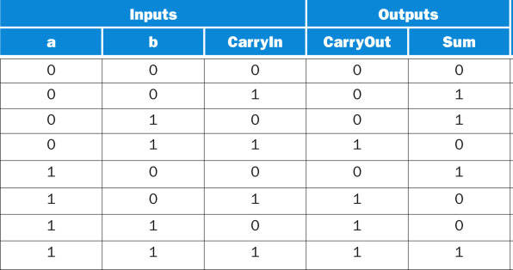
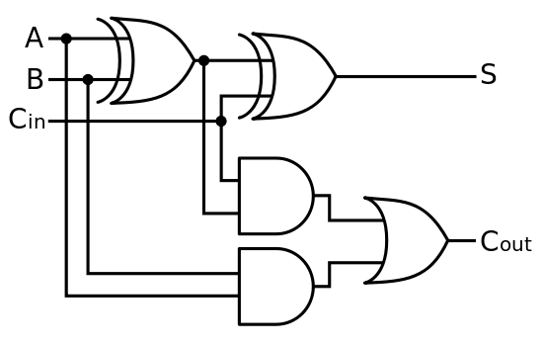
Recall 1-Bit Full Adder
Fig. A.5.3
https://commons.wikimedia.org/wiki/File:Full-adder.svg

Slide 8
From 1-bit to 4-bit ALU
1-bit ALU 4-bit ALU
Operation
Operation
CarryIn_i
2
2
CarryIn0
A_i
A0
1-bit
ALU
Result0
B0
CarryOut0
CarryIn1
Result
A1
1-bit
ALU
Result1
Mux
B1
CarryOut1
CarryIn2
A2
1-bit
ALU
Result2
1-bit
Full
Adder
B2
CarryOut2
B_i
CarryIn3
A3
1-bit
ALU
Result3
B3
CarryOut_i
Ripple-carry adder
CarryOut3
Notes:
Now that I have shown you how to build a 1-bit full adder, we have all the major components needed for this 1-bit ALU.
In order to build a 4-bit ALU, we simply connect four 1-bit ALUs in series to feed the CarryOut of one ALU to the CarryIn of the next ALU.
Even though I called this an ALU, I actually lied a little. There is something missing about this ALU. This ALU can NOT perform the subtract operation.
Let see how can we fix this problem.
2 min = 35 min. (Y:15)

Slide 9
How about Subtraction?
2’s complement operation: take inverse of every bit and add 1 (at c_{in} of first stage)
So, subtraction becomes addition of 2’s complement
A – B = A + (-B) = A + (B’ + 1) = A + B’ + 1
B’: bit-wise inverse of B
Subtract
(Bnegate)
CarryIn
1
Operation
A
2
ALU
Result
Sel
B
0
Mux
1
B’
CarryOut
Fig. A.5.8
Notes:
Recalled something you learned from grade school that: A - B is the same as A plus (-B).
Also recall from earlier slides that in order to calculate the 2’s complement representation of negative B, we simply take the inverse of very bit and add 1.
The bitwise inverse of B is easy to compute. Just pass them through the inverter.
In order to do the add 1 operation, we simply set the CarryIn to 1.
So for the subtract operation, we simply select the output of the inverter and set CarryIn to 1.
Then we will be adding A to the negative of B and whola, we have the A minus B operation.
+2 = 37 min. (Y:17)

Slide 10
Zoom-in to 1-bit ALU
Subtract
(Bnegate)
CarryIn
Operation
ALUop | Function
0000 | and
0001 | or
0010 | add
0110 | sub
0111 | set-on-less
1100 | nor
and
2
A
0
or
Result
1
Mux
Sel
1-bit
Full
Adder
add
B
0
2
Mux
B
1
B’
CarryOut
Fig. A.5.8

Slide 11
Revised Diagram
LSB and MSB need to do a little extra
A
64
B
64
a₆₃
b₆₃
a₀
b₀
4
ALU₆₃
ALU₀
?
c₀
c_{in}
ALUop
c₆₃
s₆₃
c_{in}
s₀
Supply a 1 on subtraction
64
Overflow
Zero
Combining the CarryIn and Bnegate
Result

Slide 12
Zoom-in to Rightmost Bit of ALU
Bnegate
CarryIn
Operation
ALUop | Function
0000 | and
0001 | or
0010 | add
0110 | sub
0111 | set-on-less
1100 | nor
and
2
A
0
or
Result
1
Mux
Sel
1-bit
Full
Adder
add
B
0
2
Mux
B
1
B’
CarryOut
Fig. A.5.8

Slide 13
Overflow of Signed Integer Addition
Decimal Binary Decimal 2’s complement
0 0000 0 0000
1 0001 -1 1111
2 0010 -2 1110
3 0011 -3 1101
4 0100 -4 1100
5 0101 -5 1011
6 0110 -6 1010
7 0111 -7 1001
-8 1000
Ex: 7 + 3 = 10 but ... - 4 - 5 = - 9 but …
0 1 1 1 1 0 0 0
0 1 1 1 7 1 1 0 0 -4
+ 0 0 1 1 3 + 1 0 1 1 -5
1 0 1 0 -6 0 1 1 1 7
S
S

Slide 14
Overflow Detection
Overflow: result too big/small to represent
-8 ≤ 4-bit binary number ≤ 7
Adding operands with different signs → no overflow
Overflow occurs when adding:
2 positive numbers and the sum is negative
2 negative numbers and the sum is positive
➔ sign bit is set with the value of the result
Overflow: if Carry into MSB ≠ Carry out of MSB
0 1 1 1 1 0 0 0
0 1 1 1 7 1 1 0 0 -4
+ 0 0 1 1 3 + 1 0 1 1 -5
1 0 1 0 -6 0 1 1 1 7
Notes:
Recalled from some earlier slides that the biggest positive number you can represent using 4-bit is 7 and the smallest negative you can represent is negative 8.
So any time your addition results in a number bigger than 7 or less than negative 8, you have an overflow.
Keep in mind is that whenever you try to add two numbers together that have different signs, that is adding a negative number to a positive number, overflow can NOT occur.
Overflow occurs when you to add two positive numbers together and the sum has a negative sign. Or, when you try to add negative numbers together and the sum has a positive sign.
If you spend some time, you can convince yourself that If the Carry into the most significant bit is NOT the same as the Carry coming out of the MSB, you have a overflow.
+2 = 41 min. (Y:21)

Slide 15
Overflow Detection Logic
Overflow = CarryIn[N-1] XOR CarryOut[N-1]
CarryIn0
A0
1-bit
ALU
X
Y
X XOR Y
Result0
B0
CarryOut0
0
0
0
CarryIn1
A1
1-bit
ALU
0
1
1
Result1
B1
1
0
1
CarryOut1
CarryIn2
1
1
0
A2
1-bit
ALU
Result2
B2
CarryIn3
Overflow
A3
1-bit
ALU
Result3
B3
CarryOut3
Notes:
Recall the XOR gate implements the not equal function: that is, its output is 1 only if the inputs have different values.
Therefore all we need to do is connect the carry into the most significant bit and the carry out of the most significant bit to the XOR gate.
Then the output of the XOR gate will give us the Overflow signal.
+1 = 42 min. (Y:22)

Slide 16
Nor Operation
A nor B = (not A) and (not B)
Control
Datapath
ALUop
Control signals
Register
Controller
Ainvert
CarryIn
Operation
ALU
2
V
Z
a
0
clock
0
IR
PC
1
1
ALUop Function
0000 and
0001 or
0010 add
0110 subtract
0111 set-less-than
1100 nor
Bnegate
Result
b
0
2
1
Fig. A.5.9
CarryOut
Ainvert
Bnegate
operation

Slide 17
Zero Detection Logic
To support conditional jump: by a one BIG NOR gate
CarryIn0
A0
1-bit
ALU
Result0
B0
CarryOut0
CarryIn1
A1
1-bit
ALU
Result1
B1
Zero
CarryOut1
CarryIn2
A2
1-bit
ALU
Result2
B2
CarryOut2
CarryIn3
A3
1-bit
ALU
Result3
B3
CarryOut3
Notes:
Besides detecting overflow, our ALU also needs to indicate if the result is zero.
This is easy to do. All we need is a BIG NOR gate.
Then if any of the Result bit is not zero, then the output of the NOR gate will be low.
The only time the output of the NOR gate is high is when all the result bits are zeroes.
+1 = 43 min. (Y:23)

Slide 18
Set-on-Less-Than
If A < B, then Result = 00..01, else Result = 00..00
If (A – B) < 0, then Result = 00..01, else Result = 00..00
If A – B & sign of Result is 1, then Result = 00..01, else Result = 00..00
If A – B & Result₆₃ = 1, then Result = 00..01, else Result = 00..00
If A – B & Result₆₃ = 1, then Result₀ = 1, else Result₀ = 0, while Result₆₃ ~ Result₁ = 0
A – B & Result₀ = Result₆₃, while Result₆₃ ~ Result₁ = 0
No need to do if-then-else test

Slide 19
Set on Less Than (I)
1-bit in ALU (for bits 0~62)
ALUop
Still perform a subtraction
Ainvert
CarryIn
Operation
2
But choose input as output
a
0
0
1
ALUop Function
0000 and
0001 or
0010 add
0110 subtract
0111 set-less-than
1100 nor
Bnegate
1
b
0
2
Result
1
Less
3
Copy input to output
operation
Fig. A.5.10a
Ainvert
Bnegate
CarryOut

Slide 20
Set on Less than (II)
Sign bit in ALU (bit 63)
Ainvert
CarryIn
Operation
2
a
0
0
1
Bnegate
1
Result
b
0
2
1
Less
3
If A-B < 0, Set =1
Set
Overflow
detection
Overflow
Fig. A.5.10b

Slide 21
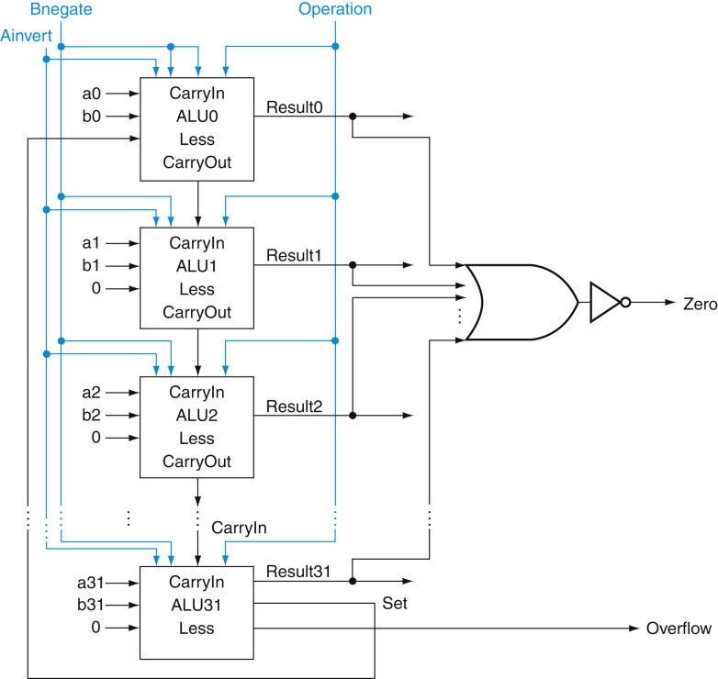
Final 64-Bit ALU
Control
Datapath
Control signals
Register
Controller
ALU
V
Z
clock
IR
PC
ALUop Function
0000 and
0001 or
0010 add
0110 subtract
0111 set-less-than
1100 nor
63
63
63
63
Fig. A.5.12

Slide 22
Verilog Behavioral Definition of 64-Bit ALU
module RISCVALU(ALUctl, A, B, ALUOut, Zero);
input [3:0] ALUctl;
input [63:0] A,B;
output reg [63:0] ALUOut;
output Zero;
assign Zero = (ALUOut==0); //Zero true if ALUOut 0
always @(ALUctl, A, B) begin //reevaluate if change
case (ALUctl)
0: ALUOut <= A & B;
1: ALUOut <= A | B;
2: ALUOut <= A + B;
6: ALUOut <= A - B;
7: ALUOut (= A < B ? 1 : 0;
12: ALUOut <= ~(A | B); // nor
default: ALUOut <= 0;
endcase
end
endmodule
ALUop Function
0000 and
0001 or
0010 add
0110 subtract
0111 set-less-than
1100 nor
Fig. A.5.15

Slide 23
RISC-V ALU Control
module ALUControl (ALUOP, FuncCode, ALUCtl);
input [1:0] ALUOP;
input [5:0] FuncCode;
output [3:0] reg ALUCtl;
always case (FuncCode)
32: ALUOP <= 2; // add
34: ALUOP <= 6; // subtract
36: ALUOP <= 0; // and
37: ALUOP <= 1; // or
39: ALUOP <= 12; // nor
42: ALUOP <= 7; // slt
default: ALUOP <= 15; // should not happen
endcase
endmodule
Fig. A.5.16

Slide 24
Problems with Ripple Carry Adder
Carry bit may have to propagate from LSB to MSB → worst case delay: N-stage delay
CarryIn0
CarryIn
A0
1-bit
ALU
A
Result0
B0
CarryOut0
CarryIn1
A1
1-bit
ALU
Result1
B1
B
CarryOut
CarryOut1
CarryIn2
A2
1-bit
ALU
Result2
B2
CarryOut2
CarryIn3
A3
1-bit
ALU
Result3
B3
By Marble machine - Own work, CC BY-SA 4.0,
https://commons.wikimedia.org/w/index.php?curid=48016289
CarryOut3
Notes:
The Adder we just built is called a Ripple Carry Adder because: Carry may have to propagate from the least significant bit to the most significant bit.
In other words, the combination of A0, B0, and CarryIn0 may cause CarryOut0 to become 1.
As a result of CarryOut0 going 1, CarryOut1 may become 1 and etc., etc., .... etc and propagate down the carry chain.
Recall the Carry Logic: CarryIn to CarryOut has a 2-gate delay.
So in the worst case, a N-bit ripple carry will have a 2N gate delay.
For a 32-bit adder, this means the worst case delay is 64 gates. This can be a problem.
So after the break, I will show you some faster way of designing an ALU.
+2 = 45 min. (Y:25)

Slide 25
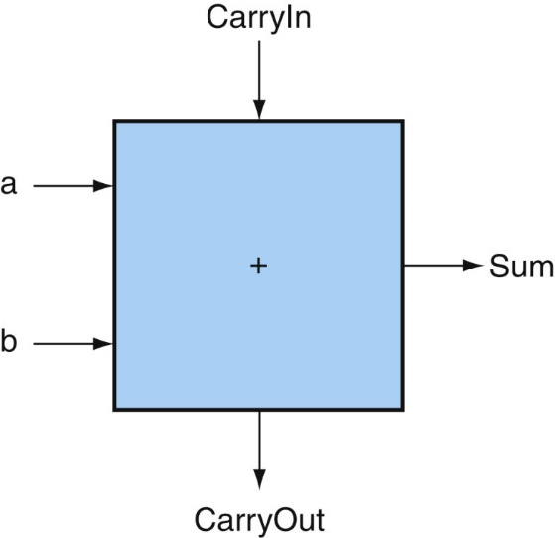
Improving Ripple Carry Adder
Strategy: determine carry in to high-order bits sooner
How? Examine how carry is generated and propagated
Carry generation: under what condition a carry is generated at a bit stage?
If a=1 and b=1, a carry is generated no matter what the value of carry input is Generate = g = a & b
Carry propagation: under what condition a carry can be propagated at a bit stage?
If only a=1 or only b=1, the value of carry input is propagated to the carry output Propagate = p = a xor b

Slide 26
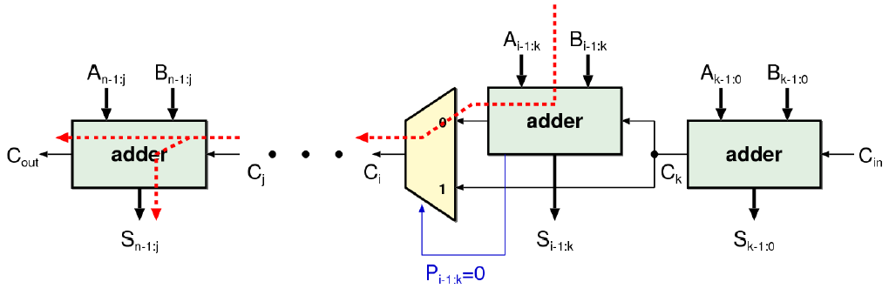
Improving Ripple Carry Adder
Carry skip adder:
P_{i-1,k} = 0 → this stage will not propagate carry → the result of the carry is generated within this stage
X
http://www.syssec.ethz.ch/education/Digitaltechnik_14

Slide 27
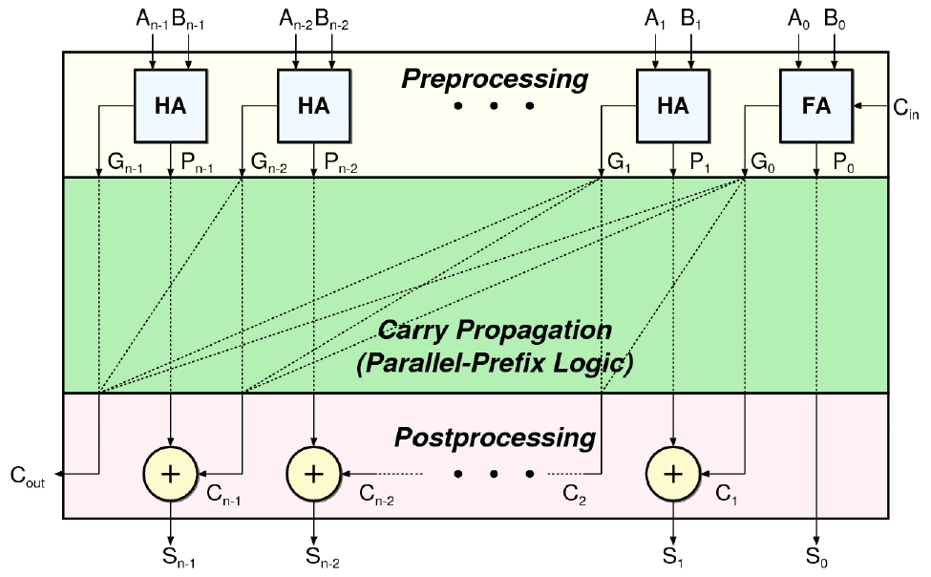

Improving Ripple Carry Adder
Carry lookahead adder:
Look ahead and anticipate the carry to come (Sec. B.6)
Fixed delay
http://www.syssec.ethz.ch/education/Digitaltechnik_14
Notes:
Cout will have a carry if An-1 and Bn-1 can generate a carry, or they can propagate a carry and An-2 and Bn-2 can generate a carry, …

Slide 28
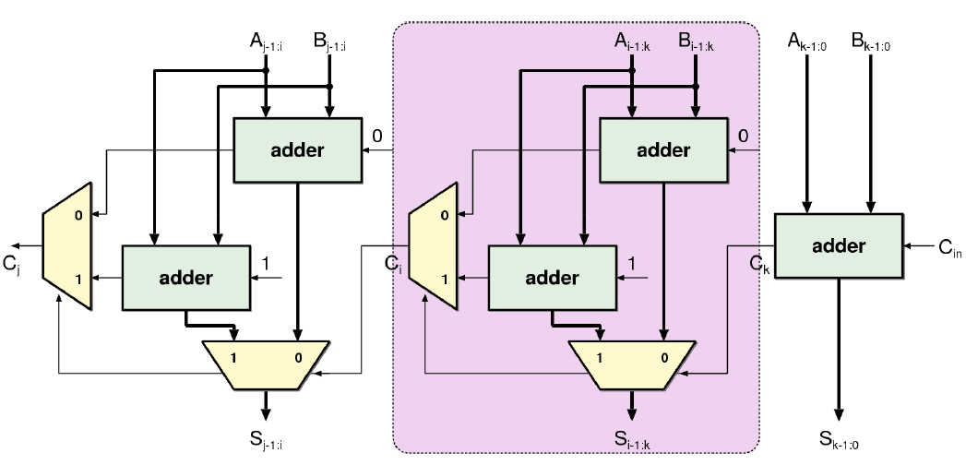
Improving Ripple Carry Adder
Carry select adder:
Design principle: parallelism (do both paths first and choose the desired result after carry in is known)
http://www.syssec.ethz.ch/education/Digitaltechnik_14

Slide 29
Outline
Addition and subtraction (Sec. 3.2)
Multiplication (Sec. 3.3)
Division (Sec. 3.4)
Floating point (Sec. 3.5)
Parallelism and computer arithmetic: subword parallelism (Sec. 3.6)
Streaming SIMD extensions and advanced vector extensions in x86 (Sec. 3.7)
Subword parallelism and matrix multiply (Sec. 3.8)

Slide 30
Unsigned Multiply
Paper and pencil example (unsigned):
1000 X 1001 00001000 00000000 00000000 01000000 01001000
m bits x n bits = m+n bit product
Binary makes it easy:
0 ➔ place 0 ( 0 x multiplicand)
1 ➔ place a copy ( 1 x multiplicand)
Multiplicand
Multiplier
Product

Slide 31
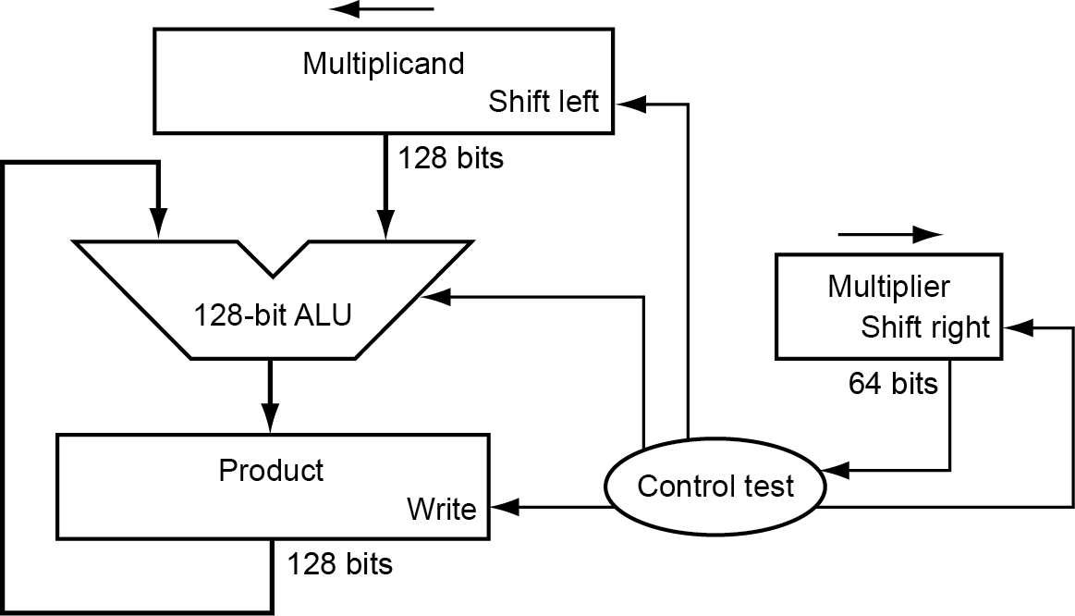
Unsigned Multiplier for RISC-V (Ver. 1)
128-bit multiplicand register (with 64-bit multiplicand at right half), 128-bit ALU, 128-bit product register, 64-bit multiplier register
Fig. 3.3

Slide 32
Multiply Algorithm (Ver. 1)
Start
Multiplier0 = 1
1. Test
Multiplier0
Multiplier0 = 0
0010 x 0011
Product Multiplier Multiplicand
0000 0000 0011 0000 0010
0000 0010 0001 0000 0100
0000 0110 0000 0000 1000
0000 0110 0000 0001 0000
0000 0110 0000 0010 0000
1a. Add multiplicand to product and
place the result in Product register
2. Shift Multiplicand register left 1 bit
3. Shift Multiplier register right 1 bit
64th
repetition?
No: < 64 repetitions
Yes: 64 repetitions
Fig. 3.4
Done
Notes:
Mpler: 0011 Mcand: 0000 0010 P: 0000 0000
1a. 1=>P=P+Mcand Mpler: 0011 Mcand: 0000 0010 P: 0000 0010
2. Shl Mcand Mpler: 0011 Mcand: 0000 0100 P: 0000 0010
3. Shr Mpler Mpler: 0001 Mcand: 0000 0100 P: 0000 0010
1a. 1=>P=P+Mcand Mpler: 0001 Mcand: 0000 0100 P: 0000 0110
2. Shl Mcand Mpler: 0001 Mcand: 0000 1000 P: 0000 0110
3. Shr Mpler Mpler: 0000 Mcand: 0000 1000 P: 0000 0110
1. 0=>nop Mpler: 0000 Mcand: 0000 1000 P: 0000 0110
2. Shl Mcand Mpler: 0000 Mcand: 0001 0000 P: 0000 0110
3. Shr Mpler Mpler: 0000 Mcand: 0001 0000 P: 0000 0110
1. 0=>nop Mpler: 0000 Mcand: 0001 0000 P: 0000 0110
2. Shl Mcand Mpler: 0000 Mcand: 0010 0000 P: 0000 0110
3. Shr Mpler Mpler: 0000 Mcand: 0010 0000 P: 0000 0110

Slide 33
Observations: Multiply Ver. 1
If 1 clock per iteration → ∼64 clocks per multiply
Ratio of multiply to addition 5:1 to 100:1
Half of the bits in multiplicand always 0 → 128-bit adder is wasteful
0’s inserted in right of multiplicand as shifted → least significant bits of product never changed once formed
Instead of shifting multiplicand to left, shift product to right?
Product register wastes space → combine Multiplier and Product register

Slide 34
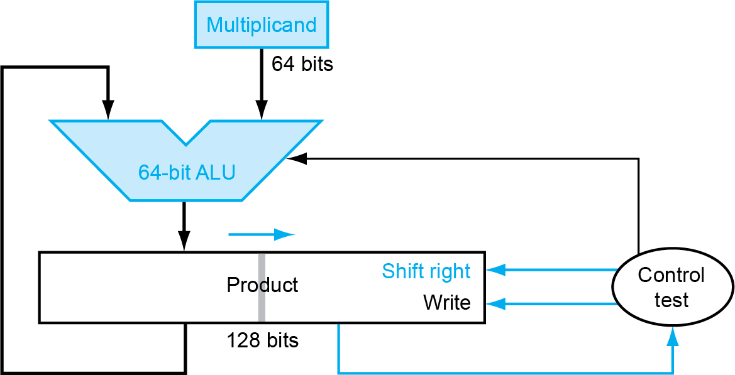
Unsigned Multiplier for RISC-V (Ver. 2)
64-bit Multiplicand register, 64-bit ALU, 128-bit Product register (0-bit Multiplier register)
Fig. 3.5

Slide 35
Multiply Algorithm (Ver. 2)
Start
Product0 = 1
1. Test
Product0
Product0 = 0
1a. Add multiplicand to left half of product and
place the result in left half of Product register
Multiplicand Product 0010 0000 0011
0010 0011
0010 0001 0001
0011 0001
0010 0001 1000
0010 0000 1100
0010 0000 0110
2. Shift Product register right 1 bit
64th
repetition?
No: < 64 repetitions
Yes: 64 repetitions
Done
Notes:
Mcand: 0010 P: 0000 0011
1a. 1=>P=P+Mcand Mcand: 0010 P: 0010 0011
2. Shr P Mcand: 0010 P: 0001 0001
1a. 1=>P=P+Mcand Mcand: 0010 P: 0011 0001
2. Shr P Mcand: 0010 P: 0001 1000
1. 0=>nop Mcand: 0010 P: 0001 1000
2. Shr P Mcand: 0010 P: 0000 1100
1. 0=>nop Mcand: 0010 P: 0000 1100
2. Shr P Mcand: 0010 P: 0000 0110

Slide 36
Observations: Multiply Ver. 2
2 steps per bit because multiplier and product registers combined
What about signed multiplication?
The easiest solution is to make both positive and remember whether to complement product when done (leave out sign bit, run for 63 steps)
Apply definition of 2’s complement
sign-extend partial products and subtract at end
Booth’s algorithm: use same HW and save cycles

Slide 37
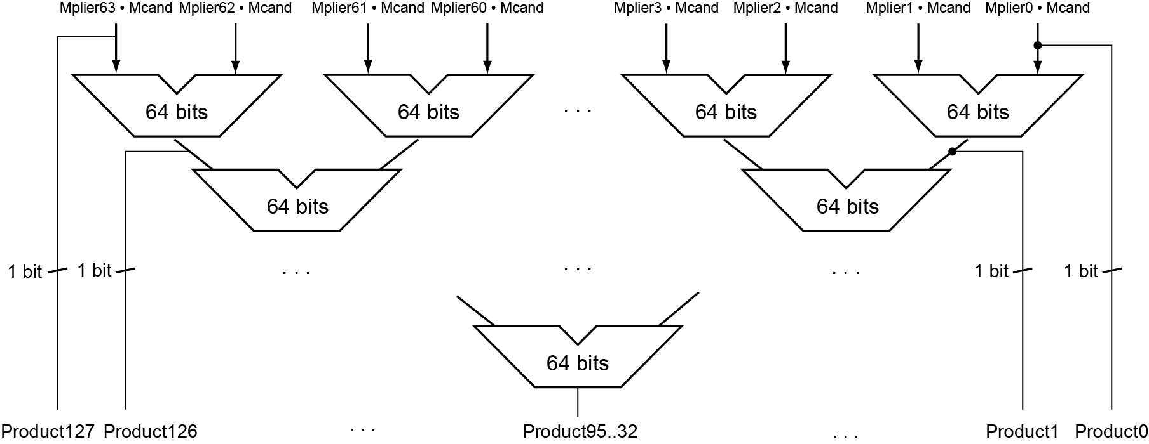
Faster Multiplier
Use multiple adders: cost/performance tradeoff
Can be pipelined: several multiplications in parallel
Fig. 3.7

Slide 38
RISC-V Integer Multiplication
To get 128-bit product:
mulh[[s]u] rdh, rs1, rs2
mul rdl, rs1,rs2
mul: multiply
Gives lower 64 bits of the product in destination register
mulh: multiply high
Gives upper 64 bits of the product in destination register, assuming signed × signed
mulhu: multiply high unsigned
Gives upper 64 bits of the product in destination register, assuming unsigned × unsigned
mulhsu: multiply high signed/unsigned
Gives upper 64 bits of the product in destination register, assuming signed × unsigned
Use mulh result to check for 64-bit overflow

Slide 39
Outline
Addition and subtraction (Sec. 3.2)
Multiplication (Sec. 3.3)
Division (Sec. 3.4)
Floating point (Sec. 3.5)
Parallelism and computer arithmetic: subword parallelism (Sec. 3.6)
Streaming SIMD extensions and advanced vector extensions in x86 (Sec. 3.7)
Subword parallelism and matrix multiply (Sec. 3.8)

Slide 40
Division
Check for 0 divisor
Long division approach
If divisor ≤ dividend bits
1 bit in quotient, subtract
Otherwise
0 bit in quotient, bring down next dividend bit
Restoring division approach
Do the subtract, and if remainder goes < 0, add divisor back
Signed division
Divide using absolute values
Adjust sign of quotient and remainder as required
quotient
dividend
1001
1000 1001010
-1000
10
101
1010
-1000
10
divisor
remainder
n-bit operands yield n-bit quotient and remainder

Slide 41
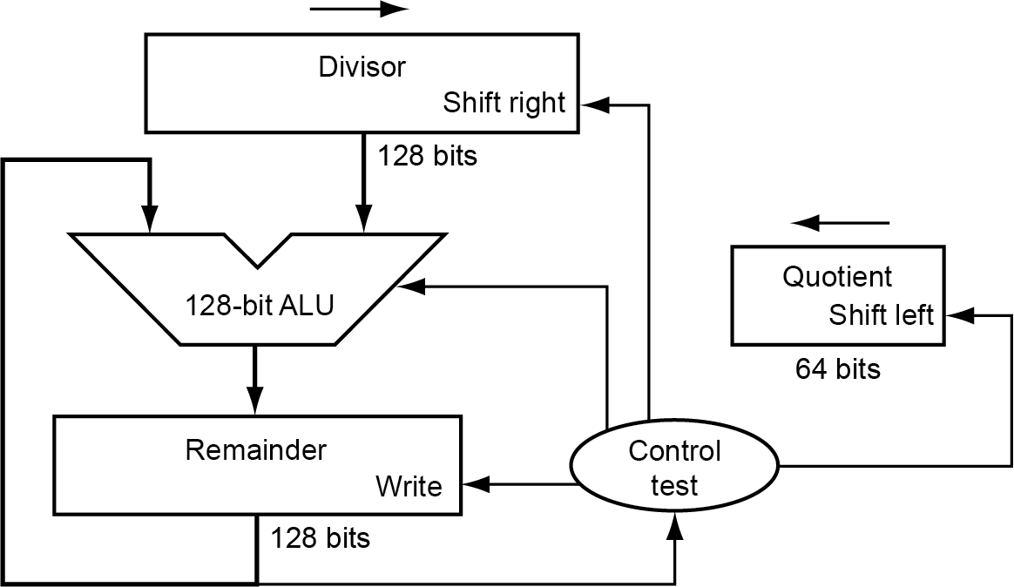
Divide Hardware for RISC-V (Version 1)
128-bit Divisor register (initialized with 64-bit divisor in left half), 128-bit ALU, 128-bit Remainder register (initialized with 128-bit dividend), 64-bit Quotient register
Fig. 3.8

Slide 42
Divide Algorithm (Version 1)
Quot. Divisor Remainder
0000 00100000 00000111
11100111
00000111
0000 00010000 00000111
11110111
00000111
0000 00001000 00000111
11111111
00000111
0000 00000100 00000111
00000011
0001 00000011
0001 00000010 00000011
00000001
0011 00000001
0011 00000001 00000001
Start: Place Dividend in Remainder
1. Subtract Divisor register from Remainder
register, place result in Remainder register
Remainder ≥ 0
Test Remainder
Remainder < 0
2a. Shift Quotient to left, set new rightmost bit to 1
2b. Restore original value by adding Divisor to Remainder, put sum in Remainder, shift Quotient to left, set new rightmost bit to 0
3. Shift Divisor register right 1 bit
65th
repetition?
No: < 65 repetitions
Yes: 65 repetitions
Fig. 3.9
Done
Notes:
Q: 0000 D: 0010 0000 R: 0000 0111  = 1110 0000
1: R = R Q: 0000 D: 0010 0000 R: 1110 0111
2b: +D, sl Q, 0 Q: 0000 D: 0010 0000 R: 0000 0111
3: Shr D Q: 0000 D: 0001 0000 R: 0000 0111  = 1111 0000
1: R = R Q: 0000 D: 0001 0000 R: 1111 0111
2b: +D, sl Q, 0 Q: 0000 D: 0001 0000 R: 0000 0111
3: Shr D Q: 0000 D: 0000 1000 R: 0000 0111  = 1111 1000
1: R = R Q: 0000 D: 0000 1000 R: 1111 1111
2b: +D, sl Q, 0 Q: 0000 D: 0000 1000 R: 0000 0111
3: Shr D Q: 0000 D: 0000 0100 R: 0000 0111  = 1111 1100
1: R = R Q: 0000 D: 0000 0100 R: 0000 0011
2a: sl Q, 1 Q: 0001 D: 0000 0100 R: 0000 0011
3: Shr D Q: 0000 D: 0000 0010 R: 0000 0011  = 1111 1110
1: R = R Q: 0000 D: 0000 0010 R: 0000 0001
2a: sl Q, 1 Q: 0011 D: 0000 0010 R: 0000 0001
3: Shr D Q: 0011 D: 0000 0001 R: 0000 0001
Recommend show 2 comp of divisor, show lines for subtract divisor and restore remainder

Slide 43
Observations: Divide Version 1
Half of the bits in divisor register always 0 → 1/2 of 128-bit adder is wasted → 1/2 of divisor is wasted
Instead of shifting divisor to right, shift remainder to left?
1st step cannot produce a 1 in quotient bit (otherwise quotient is too big for the register) → switch order to shift first and then subtract → save 1 iteration
Eliminate Quotient register by combining with Remainder register as shifted left

Slide 44
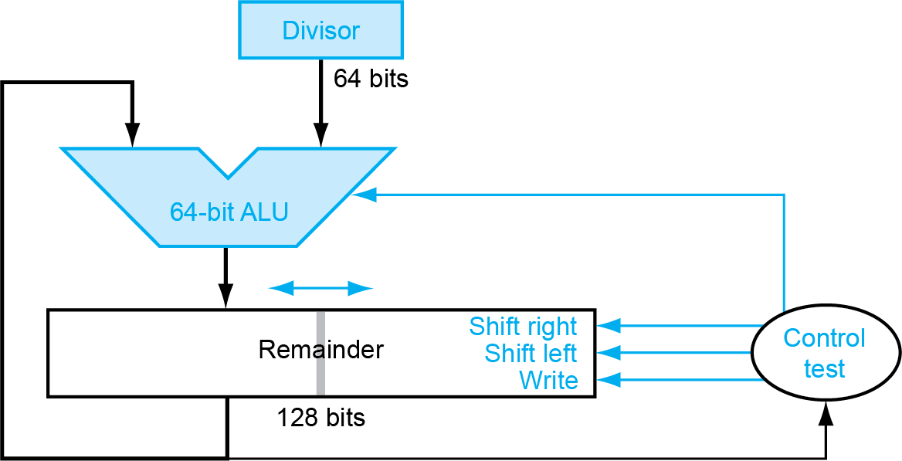
Divide Hardware (Version 2)
64-bit Divisor register, 64-bit ALU, 128-bit Remainder register (0-bit Quotient register)
Fig. 3.11
(Quotient)

Slide 45
Divide Algorithm (Version 2)
Start: Place Dividend in Remainder
Step Remainder Divisor 0 0000 0111 0010
1.1 0000 1110
1.2 1110 1110
1.3b 0001 1100
2.2 1111 1100
2.3b 0011 1000 3.2 0001 1000
3.3a 0011 0001
4.2 0001 0001
4.3a 0010 0011
0001 0011
1. Shift Remainder register left 1 bit
2. Subtract Divisor from left half of Remainder, put result in left half of Remainder
Remainder ≥ 0
Test Remainder
Remainder < 0
3a. Shift Remainder to left, setting new rightmost bit to 1
3b. Restore original value by adding Divisor to left half of Remainder, put sum there, shift Remainder to left, set new rightmost bit to 0
64th
repetition?
No: < 64 repetitions
Yes: 64 repetitions
Done. Shift left half of Remainder right 1 bit
Notes:
D: 0010 R: 0000 0111
0: Shl R D: 0010 R: 0000 1110
1: R = R D: 0010 R: 1110 1110
2b: +D, sl R, 0 D: 0010 R: 0001 1100
1: R = R D: 0010 R: 1111 1100
2b: +D, sl R, 0 D: 0010 R: 0011 1000
1: R = R D: 0010 R: 0001 1000
2a: sl R, 1 D: 0010 R: 0011 0001
1: R = R D: 0010 R: 0001 0001
2a: sl R, 1 D: 0010 R: 0010 0011
Shr R(rh) D: 0010 R: 0001 0011

Slide 46
Signed Divide
Remember signs, make positive, complement quotient and remainder if necessary
Alternative: Let Dividend and Remainder have same sign, negate Quotient if Divisor sign and Dividend sign disagree
e.g., -7÷ 2 = -3, remainder = -1
-7÷- 2 = 3, remainder = -1
Satisfy Dividend = Quotient x Divisor + Remainder
Possible for quotient to be too large:
If divide 64-bit integer by 1, quotient is 64 bits

Slide 47
Observation: Multiply and Divide
Same hardware as multiply: just need ALU to add or subtract, and 128-bit register to shift left or shift right
64-bit Multiplicand/Divisor register, 64-bit ALU, 128-bit Product/Remainder register (0-bit Multiplier/Quotient register)
Multiplicand/
Divisor
64 bits
64-bit ALU
Shift Right
Product/
Remainder
(Multiplier/
Quotient)
Shift Left
Control
128 bits
Write

Slide 48
Faster Division
Can’t use parallel hardware as in multiplier
Subtraction is conditional on sign of remainder
Faster dividers (e.g. SRT devision) generate multiple quotient bits per step
Still require multiple steps

Slide 49
RISC-V Integer Division
div/divu: signed/unsigned division
Gives 64-bit signed/unsigned quotient in destination register
rem/remu: signed/unsigned remainder
Gives 64-bit signed/unsigned remainder of the division
If both quotient and remainder are required:
div[u] rdq, rs1, rs2
rem[u] rdr, rs1, rs2
Microarchitectures can fuse them into a single division
Overflow and division-by-zero don’t produce errors
Just return defined results
Faster for the common case of no error

Slide 50
Outline
Addition and subtraction (Sec. 3.2)
Multiplication (Sec. 3.3)
Division (Sec. 3.4)
Floating point (Sec. 3.5)
Parallelism and computer arithmetic: subword parallelism (Sec. 3.6)
Streaming SIMD extensions and advanced vector extensions in x86 (Sec. 3.7)
Subword parallelism and matrix multiply (Sec. 3.8)

Slide 51
Floating-Point Numbers: Motivation
What can be represented in N bits?
Unsigned 0 to 2^{n} - 1
2’s Complement -2^{n-1} to 2^{n-1}- 1
But, what about ...
very large numbers? 9,349,398,989,787,762,244,859,087,678
very small number? 0.0000000000000000000000045691
rationals 2/3
irrationals √2
transcendentals e, π
How to represent them in just N bits?

Slide 52
Floating Point Numbers
In math, we use scientific notation to representation very small and very large numbers, e.g.,
–2.34 × 10⁵⁶
+0.002 × 10^{–4}
+987.02 × 10⁹
In binary:
Types float and double in C/C++
Normalized (exactly one non-zero digit to the left of decimal point)
Non-normalized
Floating point: binary point is not fixed (vs. fixed-point numbers such as integers)
Significand (Mantissa)
exponent
1.0_{two} x 2⁻¹
“binary point”
radix (base)

Slide 53
Intuitive Floating Point Representation
Normalized format: ±1.xxxxxxxxxx_{two} × 2^{±yyyy}two
Can use 32 bits to represent (single-precision):
S represents sign Exponent represents y’s (positive or negative) Significand represents 1.x’s
Represent numbers from 2.0 x 10⁻³⁸ to 2.0 x 10³⁸
31
30
23
22
0
S
Exponent
1.xxxxxxxx
Significand
1 bit
8 bits
23 bits
Fixed binary point
-1
0
1
Notes:
Consider 1.1111111…11 x 2^15
1.1111111…10 x 2^15

Slide 54
Intuitive Floating Point Representation
Can use 64 bits if more precision is needed (double precision)
Double precision (vs. single precision)
Represent numbers almost as small as 2.0 x 10⁻³⁰⁸ to almost as large as 2.0 x 10³⁰⁸
Main advantage is greater accuracy due to larger significand
31
30
20
19
0
S
Exponent
1.xxxxxxxx
Significand
1 bit
11 bits
20 bits
Significand (cont’d)
32 bits
Notes:
Compare 1.11111…10 x 2^15 and 1.11111…10 11111…11 x 2^15

Slide 55
Floating Point Standard
Defined by IEEE Std 754-1985
For portability; more efficient use of bits
S: sign bit (0 ⇒ non-negative, 1 ⇒ negative)
Normalized significand: 1.0 ≤ |significand| < 2.0
Always has a leading pre-binary-point 1 bit, so no need to represent it explicitly (hidden bit) → to pack more bits
Significand is Fraction with the “1.” restored
Note: 0 has no leading 1, so reserve exponent value 0 just for number 0
single: 8 bits double: 11 bits
single: 23 bits double: 52 bits
S
Exponent
Fraction

Slide 56
Floating Point Standard
Handling exponent:
Need to represent positive and negative exponents
Also want to compare FP numbers as if they were integers
If use 2’s complement to represent? e.g., 1.0 x 2⁻¹ versus 1.0 x2⁺¹ (1/2 versus 2)
If we use integer comparison for these two words, we will conclude that 1/2 > 2!!!
1/2
0
1111 1111
000 0000 0000 0000 0000 0000
2
0
0000 0001
000 0000 0000 0000 0000 0000

Slide 57
Floating Point Standard
Handling exponent: (cont.)
Instead, let notation 0000 0000 be the most negative, and 1111 1111 the most positive ➔ biased notation, where bias is the number subtracted to get the real number
IEEE 754 uses bias of 127 (0111 1111) for single precision: subtract 127 from Exponent field to get actual value for exponent
1023 (011 1111 1111) is bias for double precision
1/2
0
0111 1110
000 0000 0000 0000 0000 0000
2
0
1000 0000
000 0000 0000 0000 0000 0000

Slide 58
Floating Point Standard
Summary (single precision):
(-1)^{S} x (1.Fraction) x 2^{(Exponent-127)}
Double precision identical, except with exponent bias of 1023
31
30
23
22
0
S
Exponent
Fraction
1 bit
8 bits
23 bits

Slide 59
Single Precision Range
Exponents 00000000 and 11111111 reserved
Smallest value
Exponent: 00000001 ⇒ actual exponent = 1 – 127 = –126
Fraction: 000…00 ⇒ significand = 1.0
±1.0 × 2^{–126} ≈ ±1.2 × 10^{–38}
Largest value
Exponent: 11111110 ⇒ actual exponent = 254 – 127 = +127
Fraction: 111…11 ⇒ significand ≈ 2.0
±2.0 × 2⁺¹²⁷ ≈ ±3.4 × 10⁺³⁸

Slide 60
Double Precision Range
Exponents 0000…00 and 1111…11 reserved
Smallest value
Exponent: 00000000001 ⇒ actual exponent = 1 – 1023 = –1022
Fraction: 000…00 ⇒ significand = 1.0
±1.0 × 2^{–1022} ≈ ±2.2 × 10^{–308}
Largest value
Exponent: 11111111110 ⇒ actual exponent = 2046 – 1023 = +1023
Fraction: 111…11 ⇒ significand ≈ 2.0
±2.0 × 2⁺¹⁰²³ ≈ ±1.8 × 10⁺³⁰⁸

Slide 61
Floating Point Precision
Relative precision
All fraction bits are significant
Single precision: approximately 2^{–23}
Equivalent to 23 × log₁₀2 ≈ 23 × 0.3 ≈ 6 decimal digits of precision
Double precision: approximately 2^{–52}
Equivalent to 52 × log₁₀2 ≈ 52 × 0.3 ≈ 16 decimal digits of precision

Slide 62
Floating Point Example
Represent –0.75
–0.75 = (–1)¹ × 1.1₂ × 2^{–1}
S = 1
Fraction = 1000…00₂
Exponent = –1 + Bias
Single: –1 + 127 = 126 = 01111110₂
Double: –1 + 1023 = 1022 = 01111111110₂
Single precision: 1011111101000…00
Double precision: 1011111111101000…00

Slide 63
Floating Point Example
A more difficult case: representing 1/3?
= 0.33333…₁₀ = 0.0101010101… ₂ × 2⁰
= 1.0101010101… ₂ × 2⁻²
Sign: 0
Exponent = -2 + 127 = 125₁₀=01111101₂
Fraction = 0101010101…
This 32-bit number is only an approximation of 1/3! If we use this number as 1/3 in subsequent computations, the error will propagate and magnify
0
0111 1101
0101 0101 0101 0101 0101 010

Slide 64
Floating Point Example
What number is represented by the single-precision floating point?
11000000101000…00
S = 1
Fraction = 01000…00₂
Exponent = 10000001₂ = 129
x = (–1)¹ × (1 + 0.01₂) × 2^{(129 – 127)} = (–1) × 1.25 × 2² = –5.0
Can it also represent the following number?
1
1000 0001
0100 0000 0000 0000 0000 000
01

Slide 65
Special Numbers in IEEE 754 Standard
So far, we have not used the full range of 32/64 bits in defining floating point numbers
Consider single precision representation:
Exponent Fraction Object
0 0 ???
0 nonzero ???
1-254 anything +/- floating-point
255 0 ???
255 nonzero ???
+/- 0

Slide 66
Denormalized Numbers
Represent denormalized numbers (denorms)
Exponent: 000...0
Fraction: non-zeroes ⇒ hidden bit is 0
Allow a number to degrade in significance until it become 0 (gradual underflow)
Smallest normalized number
1.0000 0000 0000 0000 0000 000 × 2⁻¹²⁶
Smallest de-normalized number
0.0000 0000 0000 0000 0000 001 × 2⁻¹²⁶
0
0000 0000
0100 0000 0000 0000 0000 000
= 0.01₂ × 2⁻¹²⁶

Slide 67
Special Numbers in IEEE 754 Standard
So far, we have not used the full range of 32/64 bits in defining floating point numbers
Consider single precision representation:
Exponent Fraction Object
0 0 +/- 0
0 nonzero denorm
1-254 anything +/- floating-point
255 0 ???
255 nonzero ???
Denormal with fraction = 000...0
Two representations of 0.0!

Slide 68
Representation for +/- Infinity
In FP, divide by zero should produce +/- infinity, not overflow
Why?
OK to do further computations with infinity, e.g., X/0 > Y may be a valid comparison
IEEE 754 represents +/- infinity
Most positive exponent reserved for infinity
Fraction is all zeroes
S
1111 1111
0000 0000 0000 0000 0000 000

Slide 69
Special Numbers in IEEE 754 Standard
So far, we have not used the full range of 32/64 bits in defining floating point numbers
Consider single precision representation:
Exponent Fraction Object
0 0 +/- 0
0 nonzero denorm
1-254 anything +/- floating-point
255 0 +/- infinity
255 nonzero ???

Slide 70
Representation for Not a Number
What do I get if I calculate sqrt(-4.0) or 0/0?
If infinity is not an error, these should not be either
They are called Not a Number (NaN) → Exponent = 255, Fraction nonzero
Why is this useful?
Indicates illegal or undefined result
Hope NaNs help with debugging
They contaminate: op(NaN, X) = NaN
OK if calculate but don’t use it

Slide 71
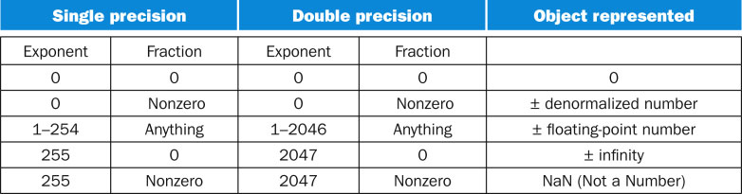
Summary: IEEE 754 FP Standard
Fig. 3.13

Slide 72
Floating Point Addition
Consider a 4-digit decimal example 9.999 × 10¹ + 1.610 × 10^{–1}
1) Align decimal points
Shift number with smaller exponent
9.999 × 10¹ + 0.016 × 10¹
2) Add significands
9.999 × 10¹ + 0.016 × 10¹ = 10.015 × 10¹
3) Normalize result and check for over/underflow
1.0015 × 10²
4) Round and renormalize if necessary
1.002 × 10²

Slide 73
Floating Point Addition
Now consider a 4-digit binary example 1.000₂ × 2^{–1} + –1.110₂ × 2^{–2} (0.5 + –0.4375)
1) Align binary points
Shift number with smaller exponent
1.000₂ × 2^{–1} + –0.111₂ × 2^{–1}
2) Add significands
1.000₂ × 2^{–1} + –0.111₂ × 2^{–1} = 0.001₂ × 2^{–1}
3) Normalize result and check for over/underflow
1.000₂ × 2^{–4}, with no over/underflow
4) Round and renormalize if necessary
1.000₂ × 2^{–4} (no change) = 0.0625

Slide 74
FP Adder Hardware
Much more complex than integer adder
Doing it in one clock cycle would take too long
Much longer than integer operations
Slower clock would penalize all instructions
FP adder usually takes several cycles
Can be pipelined

Slide 75
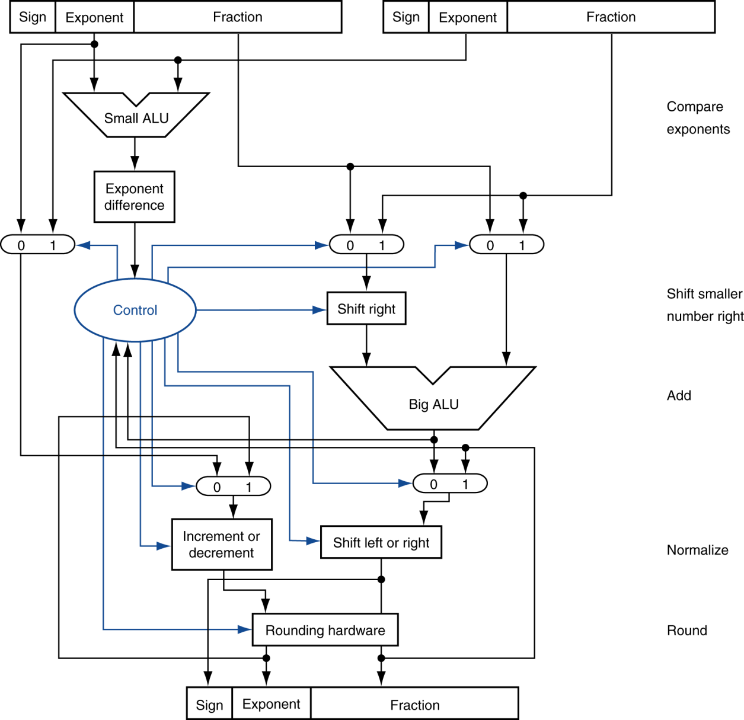
FP Adder
Step 1
Step 2
Step 3
Step 4
Fig. 3.15

Slide 76
Floating Point Multiplication
Consider a 4-digit decimal example 1.110 × 10¹⁰ × 9.200 × 10^{–5}
1) Add exponents
For biased exponents, subtract bias from sum
New exponent = 10 + –5 = 5
2) Multiply significands
1.110 × 9.200 = 10.212 ⇒ 10.212 × 10⁵
3) Normalize result and check for over/underflow
1.0212 × 10⁶
4) Round and renormalize if necessary
1.021 × 10⁶
5) Determine sign of result from signs of operands
+1.021 × 10⁶

Slide 77
Floating Point Multiplication
Now consider a 4-digit binary example 1.000₂ × 2^{–1} × –1.110₂ × 2^{–2} (0.5 × –0.4375)
1) Add exponents
Unbiased: –1 + –2 = –3
Biased: (–1 + 127) + (–2 + 127) = –3 + 254 – 127 = –3 + 127
2) Multiply significands
1.000₂ × 1.110₂ = 1.1102 ⇒ 1.110₂ × 2^{–3}
3) Normalize result and check for over/underflow
1.110₂ × 2^{–3} (no change) with no over/underflow
4) Round and renormalize if necessary
1.110₂ × 2^{–3} (no change)
5) Determine sign: +ve × –ve ⇒ –ve
–1.110₂ × 2^{–3} = –0.21875

Slide 78
FP Arithmetic Hardware
FP multiplier is of similar complexity to FP adder
But uses a multiplier for significands instead of an adder
FP arithmetic hardware usually does
Addition, subtraction, multiplication, division, reciprocal, square-root
FP ↔ integer conversion
Operations usually takes several cycles
Can be pipelined

Slide 79
FP Instructions in RISC-V
Separate FP registers: f0, …, f31
double-precision
single-precision values stored in the lower 32 bits
FP instructions operate only on FP registers
Programs generally don’t do integer ops on FP data, or vice versa
More registers with minimal code-size impact
FP load and store instructions
Single precision load/store: flw, fsw
Double precision load/store: fld, fsd

Slide 80
FP Instructions in RISC-V
Single-precision arithmetic
fadd.s, fsub.s, fmul.s, fdiv.s, fsqrt.s
e.g., fadds.s f2, f4, f6
Double-precision arithmetic
fadd.d, fsub.d, fmul.d, fdiv.d, fsqrt.d
e.g., fadd.d f2, f4, f6
Single- and double-precision comparison
feq.s, flt.s, fle.s
feq.d, flt.d, fle.d
Result is 0 or 1 in integer destination register
feq.d x5,f0,f1

Slide 81
FP Example: °F to °C
C code:
float f2c(float fahr) { return ((5.0/9.0)*(fahr - 32.0)); }
fahr in f10, result in f10, literals in global memory space
Compiled RISC-V code:
f2c: flw f0,const5(x3) // f0 = 5.0f
flw f1,const9(x3) // f1 = 9.0f
fdiv.s f0,f0,f1 // f0 = 5.0f/9.0f
flw f1,const32(x3) // f1 = 32.0f
fsub.s f10,f10,f1 // f10 = fahr–32.0
fmul.s f10,f0,f10 // f10 = () * ()
jalr x0,0(x1) // return

Slide 82
FP Example: Array Multiplication
C = C + A × B
All 32 × 32 matrices, 64-bit double-precision elements
C code:
void mm (double c[][], double a[][], double b[][]) { size_t i, j, k; for (i = 0; i < 32; i = i + 1) for (j = 0; j < 32; j = j + 1) for (k = 0; k < 32; k = k + 1) c[i][j] = c[i][j] + a[i][k] * b[k][j]; }
Addresses of c, a, b in x10, x11, x12, and i, j, k in x5, x6, x7

Slide 83
FP Example: Array Multiplication
RISC-V code:
mm:...
li x28,32 // x28 = 32 (row size/loop end)
li x5,0 // i = 0; initialize 1st for loop
L1: li x6,0 // j = 0; initialize 2nd for loop
L2: li x7,0 // k = 0; initialize 3rd for loop
slli x30,x5,5 // x30 = i * 2**5 (size of row of c)
add x30,x30,x6 // x30 = i * size(row) + j
slli x30,x30,3 // x30 = byte offset of [i][j]
add x30,x10,x30 // x30 = byte address of c[i][j]
fld f0,0(x30) // f0 = c[i][j]
L3: slli x29,x7,5 // x29 = k * 2**5 (size of row of b)
add x29,x29,x6 // x29 = k * size(row) + j
slli x29,x29,3 // x29 = byte offset of [k][j]
add x29,x12,x29 // x29 = byte address of b[k][j]
fld f1,0(x29) // f1 = b[k][j]

Slide 84
FP Example: Array Multiplication
RISC-V code:
li x28,32 // x28 = 32 (row size/loop end)
li x5,0 // i = 0; initialize 1st for loop
L1: li x6,0 // j = 0; initialize 2nd for loop
L2: li x7,0 // k = 0; initialize 3rd for loop
slli x30,x5,5 // x30 = i * 2^5 (size of row of c)
add x30,x30,x6 // x30 = i * size(row) + j
slli x30,x30,3 // x30 = byte offset of [i][j]
add x30,x10,x30 // x30 = byte address of c[i][j]
fld f0,0(x30) // f0 = c[i][j]
L3: slli x29,x7,5 // x29 = k * 2^5 (size of row of b)
add x29,x29,x6 // x29 = k * size(row) + j
slli x29,x29,3 // x29 = byte offset of [k][j]
add x29,x12,x29 // x29 = byte address of b[k][j]
fld f1,0(x29) // f1 = b[k][j]

Slide 85
FP Example: Array Multiplication
slli x29,x5,5 // x29 = i * 2^5 (size of row of a)
add x29,x29,x7 // x29 = i * size(row) + k
slli x29,x29,3 // x29 = byte offset of [i][k]
add x29,x11,x29 // x29 = byte address of a[i][k]
fld f2,0(x29) // f2 = a[i][k]
fmul.d f1, f2, f1 // f1 = a[i][k] * b[k][j]
fadd.d f0, f0, f1 // f0 = c[i][j] + a[i][k] * b[k][j]
addi x7,x7,1 // k = k + 1
bltu x7,x28,L3 // if (k < 32) go to L3
fsd f0,0(x30) // c[i][j] = f0
addi x6,x6,1 // j = j + 1
bltu x6,x28,L2 // if (j < 32) go to L2
addi x5,x5,1 // i = i + 1
bltu x5,x28,L1 // if (i < 32) go to L1

Slide 86
Accurate Arithmetic
Integer arithmetic is accurate
Because integers can represent exactly every number between the smallest and largest number
FP arithmetic is approximate
Because FP numbers are just approximations for the actual number they want to represent
The approximation errors widen as FP numbers are operated upon to generate new FP numbers
Need to be careful in rounding intermediate results
IEEE Std 754 specifies additional rounding control
Use extra bits during HW calculation to preserve precision (guard, round, sticky) and allow choice of rounding modes
Notes:
IEEE Std 754 specifies additional rounding control
Extra bits of precision (guard, round, sticky)
Choice of rounding modes
Allows programmer to fine-tune numerical behavior of a computation
Not all FP units implement all options
Most programming languages and FP libraries just use defaults
Trade-off between hardware complexity, performance, and market requirements

Slide 87
Associativity of FP Operations
Is FP add/subtract associative?
FP add/subtract are not associative!
Why? FP result approximates real result!
Ex: 1.5 x 10³⁸ is so much larger than 1.0 that 1.5 x 10³⁸ + 1.0 in floating point representation is still 1.5 x 10³⁸
 |  | (X + Y ) + Z | X + (Y + Z)
X | -1.50 x 10³⁸ |  | -1.50 x 10³⁸
Y | 1.50 x 10³⁸ | 0.0
Z | 1.0 | 1.0 | 1.50 x 10³⁸
 |  | 1.0 | 0.0

Slide 88
Outline
Addition and subtraction (Sec. 3.2)
Multiplication (Sec. 3.3)
Division (Sec. 3.4)
Floating point (Sec. 3.5)
Parallelism and computer arithmetic: subword parallelism (Sec. 3.6)
Streaming SIMD extensions and advanced vector extensions in x86 (Sec. 3.7)
Subword parallelism and matrix multiply (Sec. 3.8)

Slide 89
Arithmetic for Multimedia
Graphics and media processing often perform same operations on vectors of 8-bit and 16-bit data
These data are often packed into words
How to operate on these words of short data?
Since we have already had 64-bit adder, can we leverage it?
Partition the carry chain of the 64-bit adder so that the adder can perform 8 8-bit or 4 16-bit vector add/sub
This is called subword parallelism
Saturating operations
On overflow, result is the largest representable value, e.g., clipping in audio, saturation in video

Slide 90
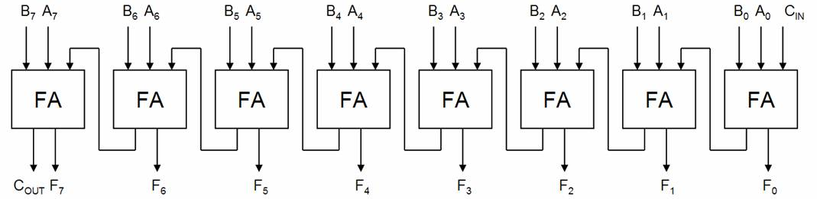
Subword Parallelism
An 8-bit ripple-carry adder:
Turned into 2 4-bit ripple-carry adder:
0
X
http://ece-research.unm.edu/pollard/classes/338/lademo/LookAheadDemo.htm

Slide 91
Fallacies and Pitfalls
Left shift by i places → multiplies an integer by 2^{i}
Right shift by i places divides by 2^{i}?
Only for unsigned integers
For signed integers
Arithmetic right shift: replicate the sign bit
e.g., –5 / 4 11111011₂ >> 2 = 11111110₂ = –2
Rounds toward –∞
If we only do logic shift right, 11111011₂ >> 2 = 00111110₂ = +62

Slide 92
Summary
MIPS arithmetic: successive refinement to final design
64-bit adder and logic unit
64-bit multiplier and divisor
FP numbers approximate values that we want to use
IEEE 754 Standard is most widely accepted representation
New RISC-V registers (f0~f31) and instructions:
Single-precision (32 bits): fadd.s, fsub.s, fmul.s, fdiv.s, fsqrt.s , feq.s, flt.s, fle.s
Double-precision (64 bits): fadd.d, fsub.d, fmul.d, fdiv.d, fsqrt.d, feq.d, flt.d, fle.d

Slide 93
Concluding Remarks
Bits have no inherent meaning
Interpretation depends on the instructions applied
Computer representations of numbers
Finite range and precision
Need to account for this in programs
ISAs support arithmetic
Signed and unsigned integers
Floating-point approximation to reals
Bounded range and precision
Operations can overflow and underflow

